Slide 1
DBS LAB PROJECT :
ONLINE SHOPPING CART MANAGEMENT SYSTEM
Team members:
Name: reg no:
Neha Das 240953396
Akshita Kambhampati 240953049

Slide 2
DESKTOP SHOPPING SYSTEM
Allows users to:
Browse products
Add to cart
Place orders
Built using:
Java Swing (Frontend)
Oracle Database- SQL plus (Backend)
JDBC + PL/SQL

Slide 3
OBJECTIVE
Automate online shopping process
Maintain product & user data efficiently
Ensure secure order processing
Maintain stock integrity using DBMS

Slide 4
SYSTEM ARCHITECTURE
User (GUI - Java Swing)
↓
JDBC Connection
↓
Oracle Database
(Users, Products, Cart, Orders)
↓
PL/SQL (Procedures + Triggers)

Slide 5
DATABASE DESIGN
USERS(user_id pk, name, email, password, role)
PRODUCT(product_id pk, name, price, stock, category_id)
CART(cart_id pk, user_id fk)
CART_ITEM(cart_item_id pk, cart_id fk, product_id fk, quantity)
ORDERS(order_id pk, user_id fk, order_date, total_amount)
ORDER_ITEM(order_item_id pk, order_id fk, product_id fk, quantity, price)
CATEGORY(category_id, category_name)

Slide 6
Er diagram

Slide 7
REQUIREMENTS OVERVIEW
REQ 1 – User management REQ 2 – Product management REQ 3 – Product search REQ 4 – Add to cart REQ 5 – Remove from cart REQ 6 – Stock validation REQ 7 – Order generation REQ 8 – Stock update REQ 9 – Transaction storage REQ 10 – Admin operations REQ 11 – Data integrity REQ 12 – Order history

Slide 8
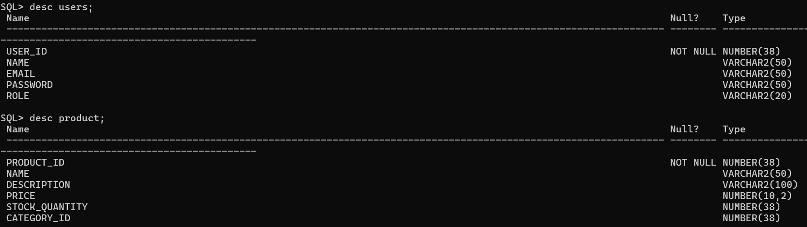
REQ 1–2 (USER & PRODUCT)
USERS table stores: customers/admins PRODUCT table stores: ID, Name, Price, Stock_quantity, category_id

Slide 9
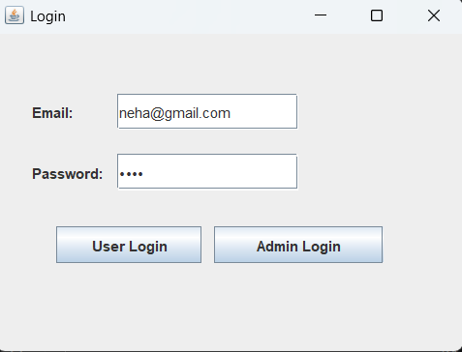
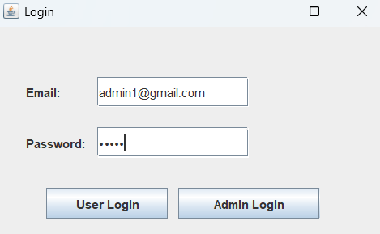
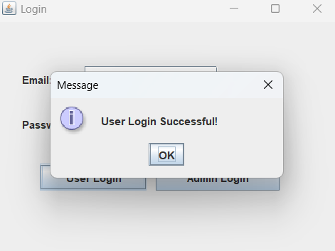
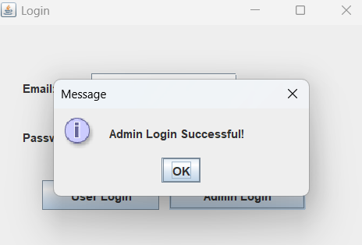
Customer login
Admin login

Slide 10
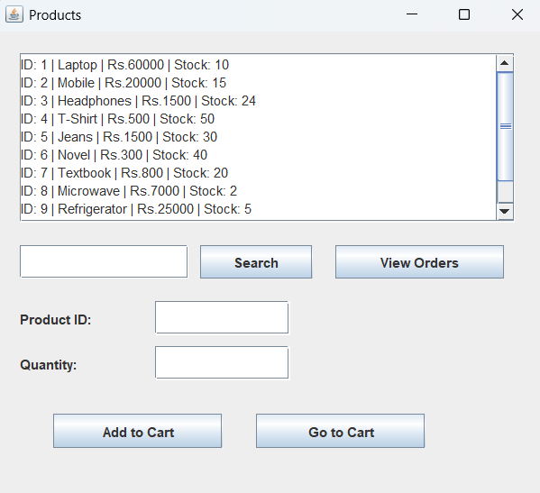
Product page

Slide 11
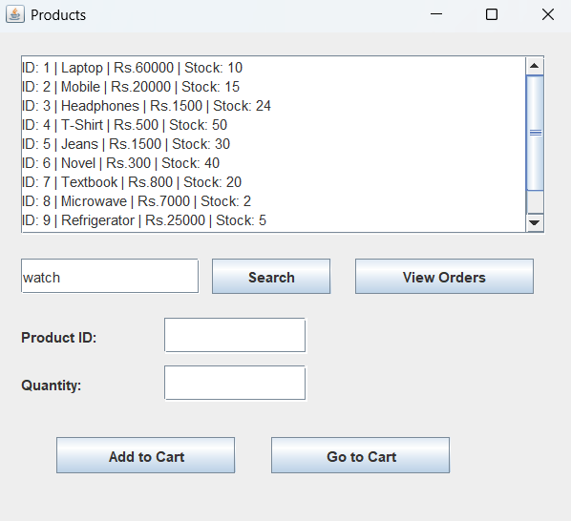
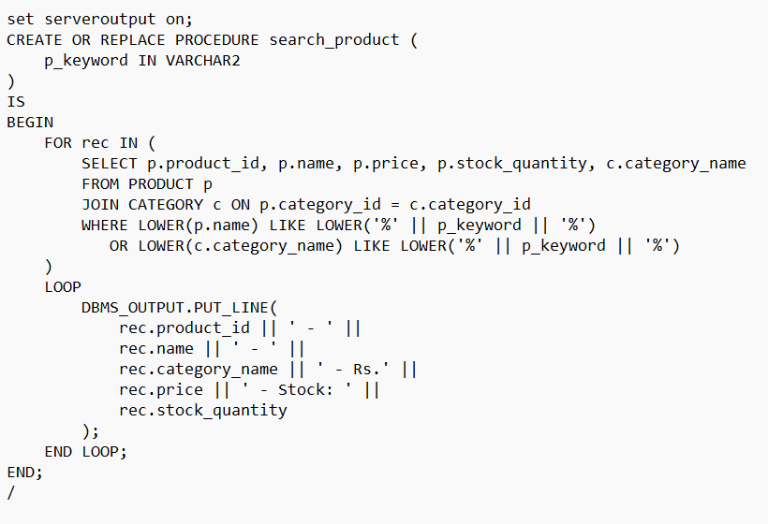
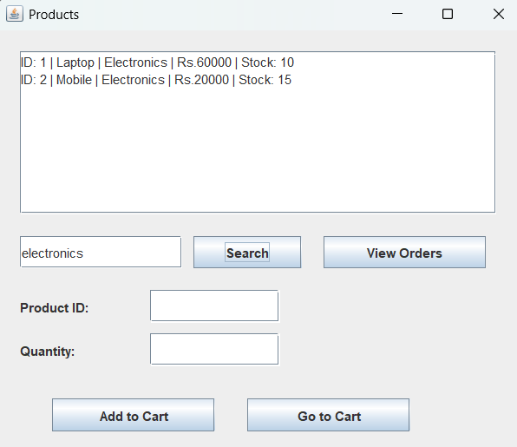
REQ 3–5 (CART FEATURES)
Product searching

Slide 12
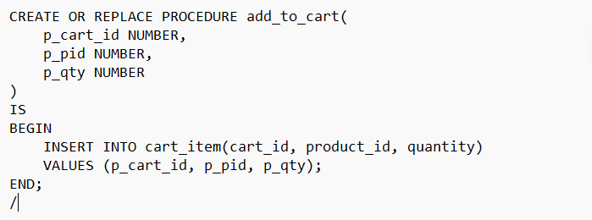
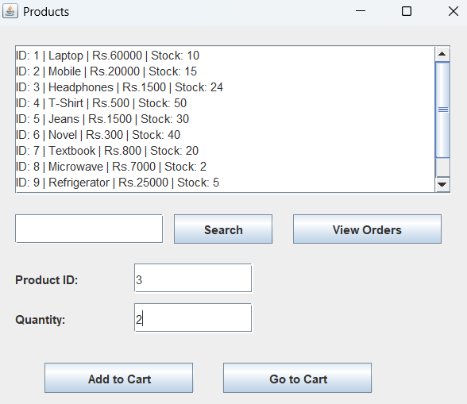
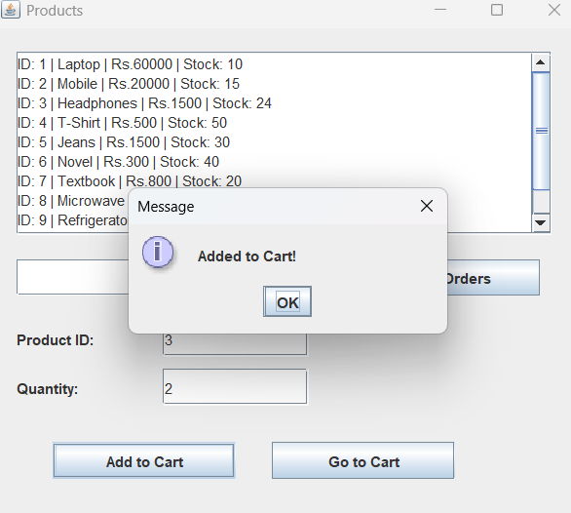
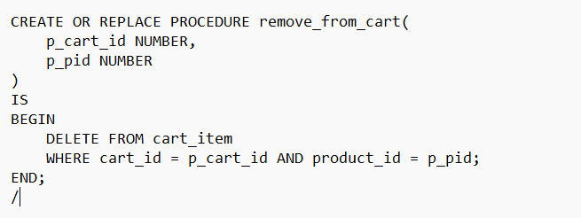
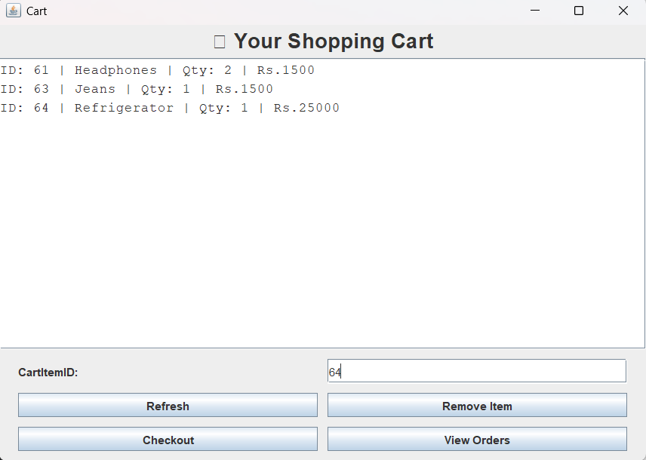
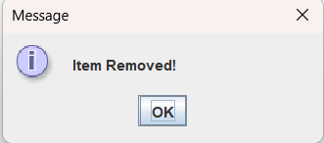
Add to cart
Remove items using CartItemId

Slide 13
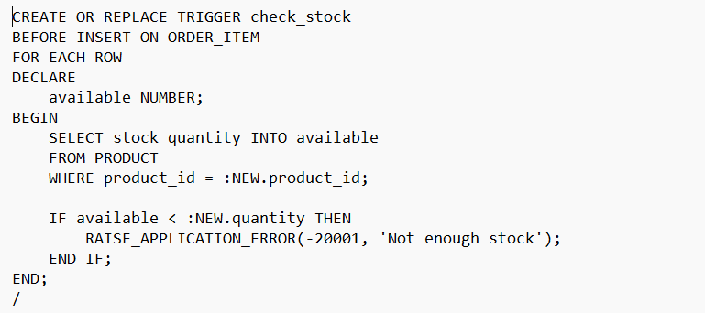
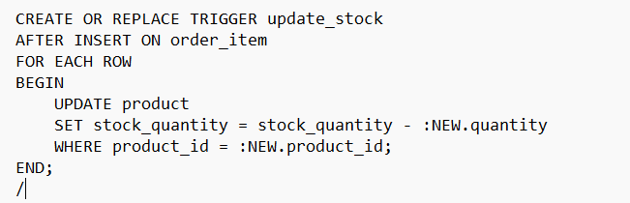
REQ 6 (STOCK VALIDATION)
Check stock availability :
Update stock :
(Requirement 8)

Slide 14
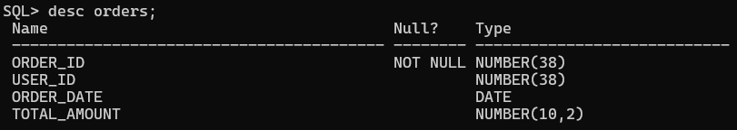
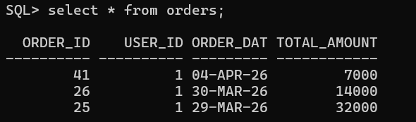
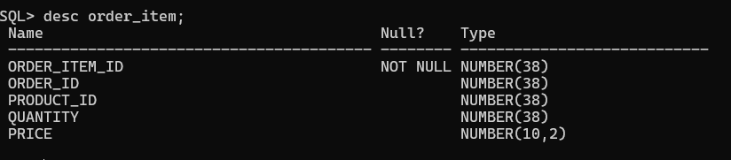
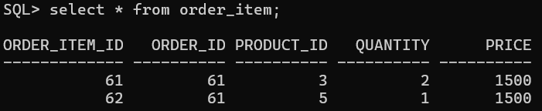
REQ 7–9 (ORDER PROCESSING)
Order created in ORDERS table
Items stored in ORDER_ITEM

Slide 15
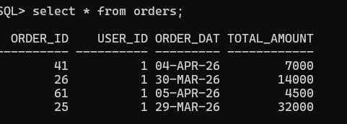
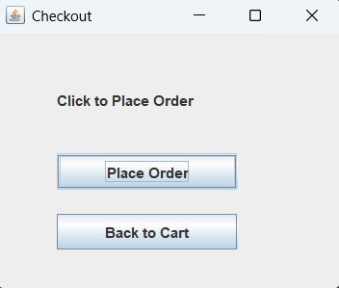
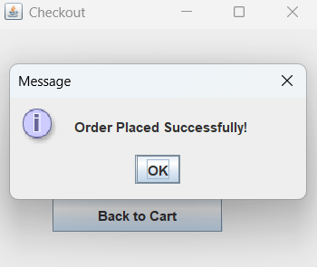
Total is calculated and stored in ORDERS table

Slide 16
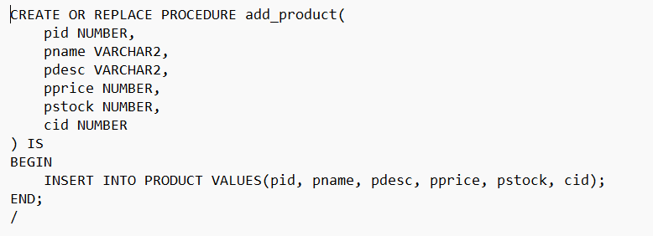
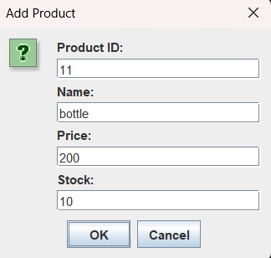
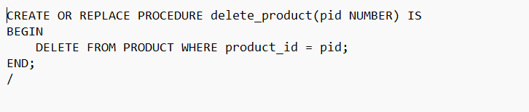
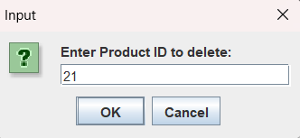
REQ 10 (ADMIN MODULE)
add_product: procedure used to insert a new product into the PRODUCT table by the admin
delete_product: procedure used to delete a product by the admin

Slide 17
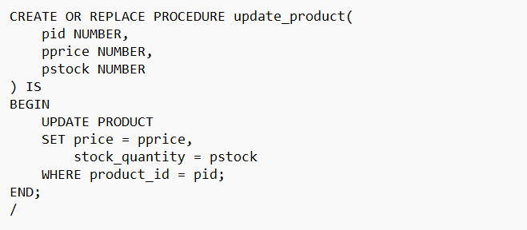
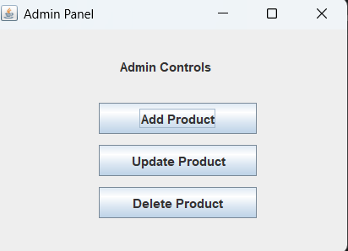
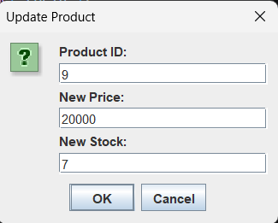
update_product: procedure used to update product details by the admin

Slide 18
REQ 11 (DATA INTEGRITY)
Trigger ensures: No negative stock

Slide 19
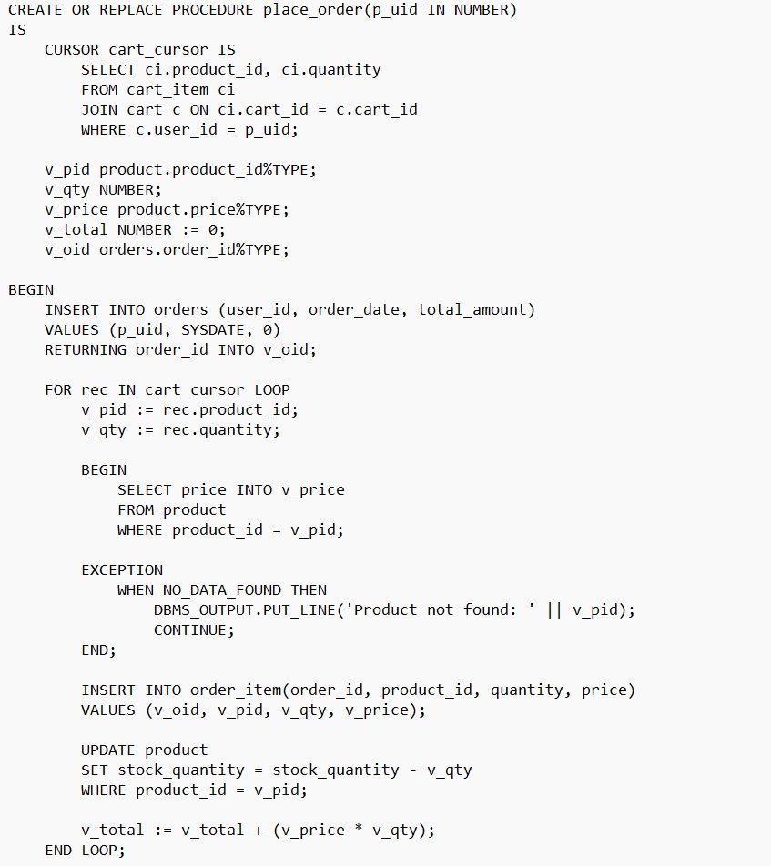
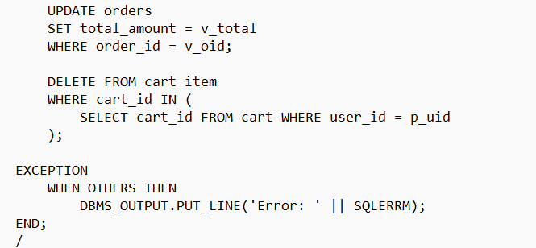
No invalid orders by checking if the product is present

Slide 20
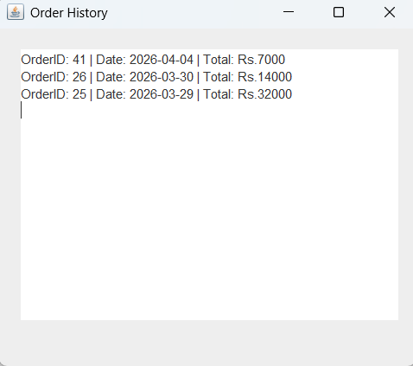
REQ 12 (ORDER HISTORY)
Users can view past orders
From product page

Slide 21
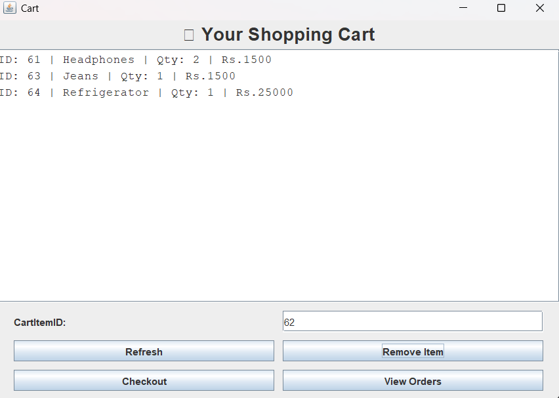
From cart page

Slide 22
Data fetched from ORDERS table

